Slide 1
Usage of Prepositions
Dr. T. SUNAND EMMANUEL

Slide 2
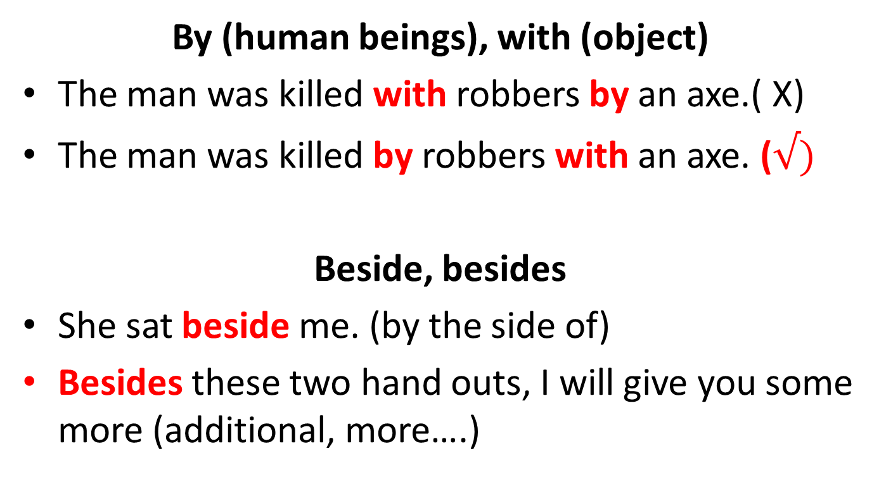
Prepositions
By (human beings), with (object)
The man was killed with robbers by an axe.( X)
The man was killed by robbers with an axe. ($√)$
Beside, besides
She sat beside me. (by the side of)
Besides these two hand outs, I will give you some more (additional, more….)

Slide 3
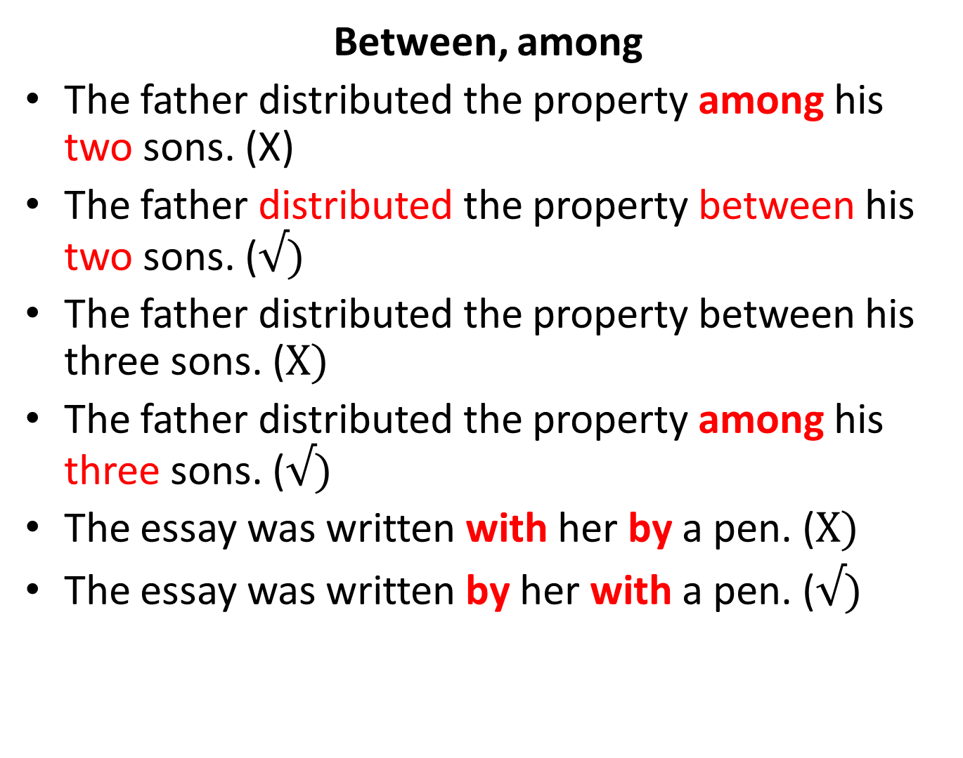
Between (two people) …….. Among (> two people)
Between, among
The father distributed the property among his two sons. (X)
The father distributed the property between his two sons. ($√)$
The father distributed the property between his three sons. ($X)$
The father distributed the property among his three sons. ($√)$
The essay was written with her by a pen. ($X)$
The essay was written by her with a pen. ($√)$

Slide 4
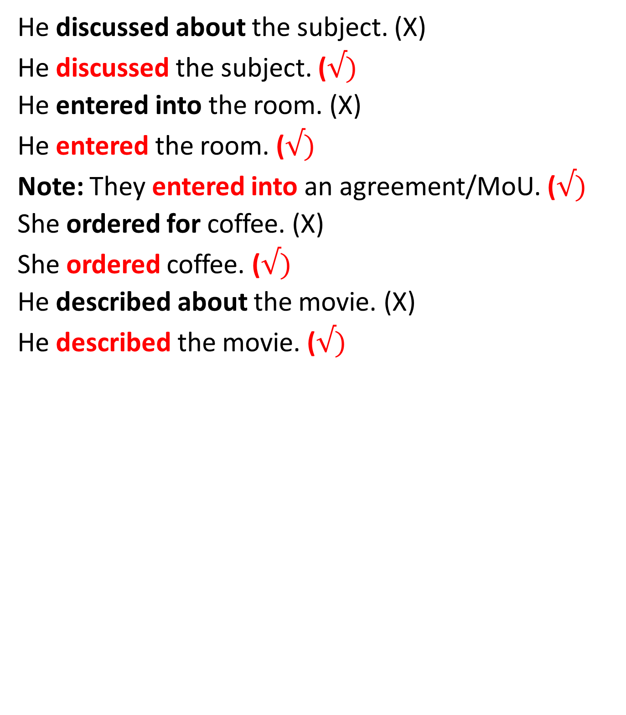
discuss, describe, order, enter– NO prepositions after them
He discussed about the subject. (X)
He discussed the subject. ($√)$
He entered into the room. (X)
He entered the room. ($√)$
Note: They entered into an agreement/MoU. ($√)$
She ordered for coffee. (X)
She ordered coffee. ($√)$
He described about the movie. (X)
He described the movie. ($√)$

Slide 5
prohibit
prevent
Refrain + from + -ing
proscribe

Slide 6
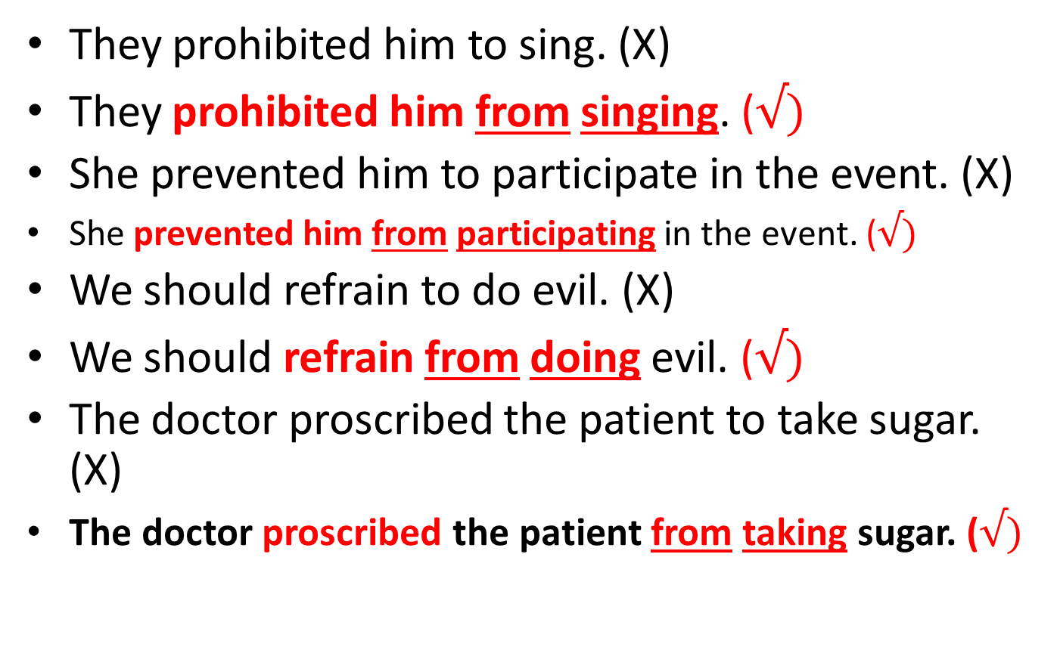
Prohibit, prevent, refrain, proscribe + from+ -ing
They prohibited him to sing. (X)
They prohibited him from singing. ($√)$
She prevented him to participate in the event. (X)
She prevented him from participating in the event. ($√)$
We should refrain to do evil. (X)
We should refrain from doing evil. ($√)$
The doctor proscribed the patient to take sugar. (X)
The doctor proscribed the patient from taking sugar. ($√)$

Slide 7
junior
senior
inferior
superior
posterior + to
anterior
prior
prefer
He is junior than me. (X)
John is senior than me. (X)
This book is inferior than that. (X)
This movie book is superior than that. (X)

Slide 8
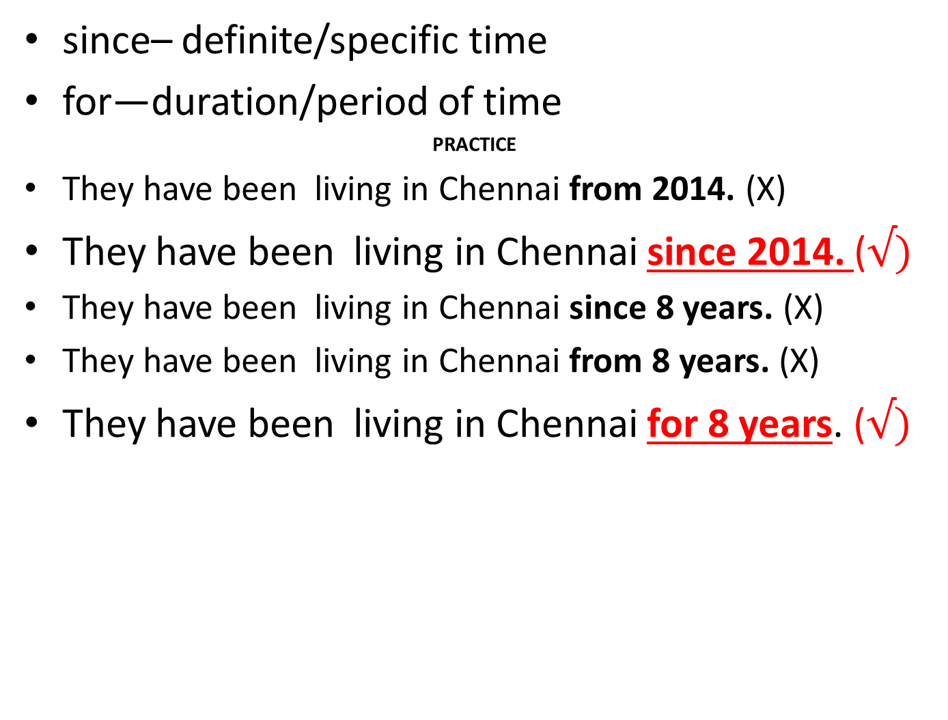
Since, for
since– definite/specific time
for—duration/period of time
PRACTICE
They have been living in Chennai from 2014. (X)
They have been living in Chennai since 2014. ($√)$
They have been living in Chennai since 8 years. (X)
They have been living in Chennai from 8 years. (X)
They have been living in Chennai for 8 years. ($√)$

Slide 9
9 am
Since + 5 pm
yesterday for + 20 seconds
2014 40 minutes
last Tuesday 5 hours morning 10 days
Deepavali 4 months 20 years
a long time

Slide 10
Some sentences
Kriti was born in 2002.
Teja did his assignment on Monday.
The students wrote the exams in November.
Manasa came at 5 pm.
The train came on time. (exact)
The train came in time. (before the scheduled time)

Slide 11
Read these sentences
He was born in Hyderabad.
He was born at LB Nagar in Hyderabad. (small place, big place)
The cat is on the table.
The cat jumped upon the table. (action)
The students are in the room.
The principal went into the room. (action)

Slide 12
Usage of prepositions
He deals in Chinese silk. (business)
How do you deal with this issue?
We must abstain from evil and do good.
We agreed with them on all points.
The old woman was confined to bed.
They was charged with murder finally.

Slide 13
Usage of prepositions
There is no exception to that rule.
He was indifferent to their comments.
She is married to a rich man.
She resigned herself to her fate.
Please deal fairly with your others.
He deals in American silk. (business).
I am vexed with this issue.
Can somebody cure him of his disease?
She takes after his mother in good looks.
She did not come up to my expectations.

Slide 14
Usage of prepositions
She prefers a book of adventures to one of travels.
I am not blind to my faults.
They made a living by begging from door to door.
I was annoyed with her yesterday.
Don’t be vain of your beauty.
She parted from her children.
She parted with her money.
She has reconciled herself with her lot.

Slide 15
Usage of prepositions
What is time ____ your watch? (in, by)
This book is different _____ that. (than, from)
We wrote the exam ____ ink. (with, in)
The old man was struck ___ a stone. (by, with)
She was killed ____ robbers. (by, with)
She sat ____ me. (beside, besides)
_____ her, two other friends were there. (beside, besides)

Slide 16
Usage of prepositions
I will differ ______ you on this issue. (from, with)
Why are you angry ____ her? (at, her)
Why are you angry ____ the postal delay? (at, her)
We agree _______ you. (to, with)
We agree _______ the proposal. (to, with)
I agree ____your proposal now, but I will not agree ____ you next time. (with, to)

